Slide 1

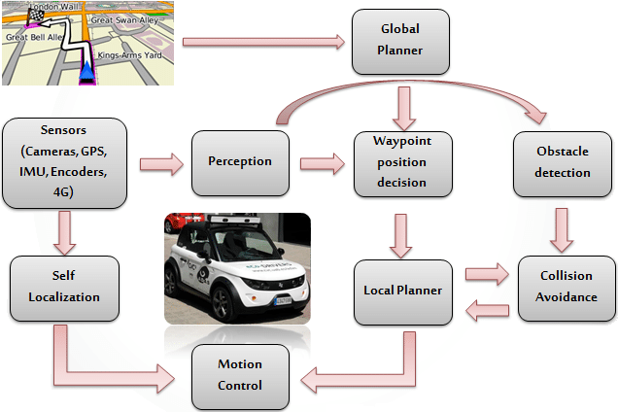
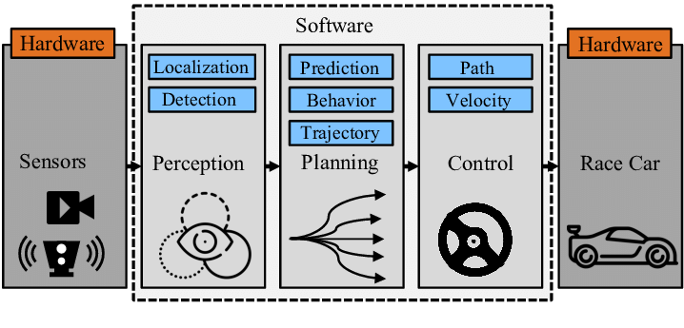
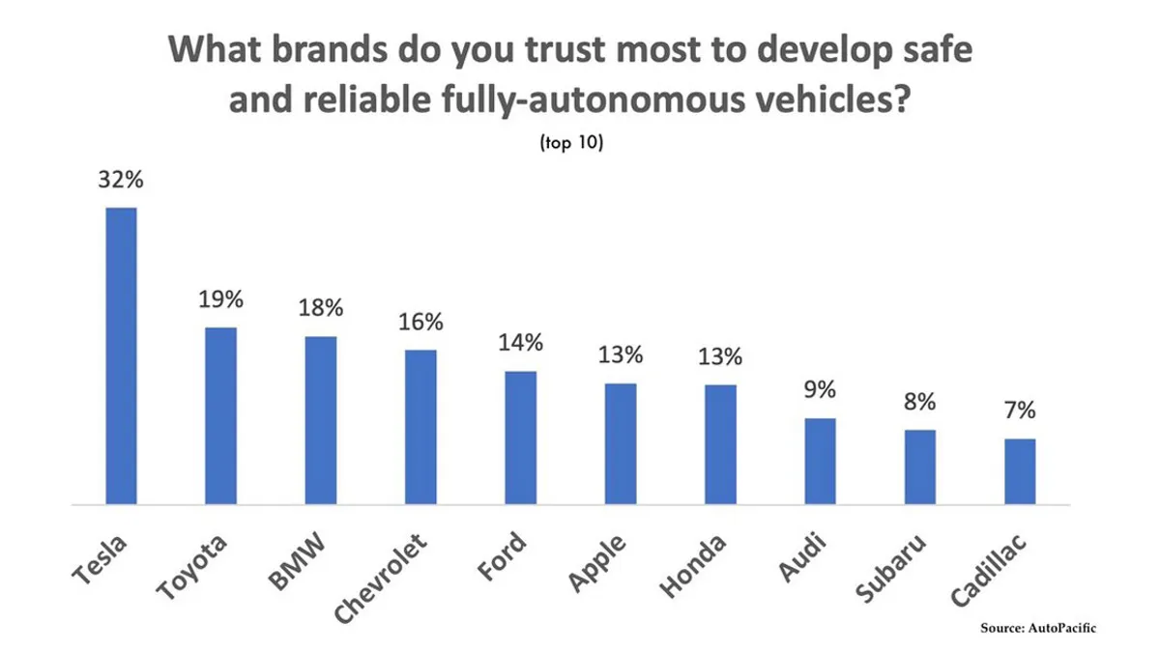
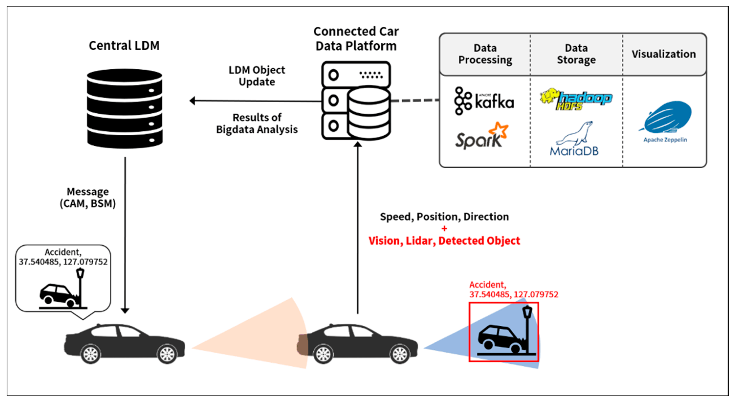

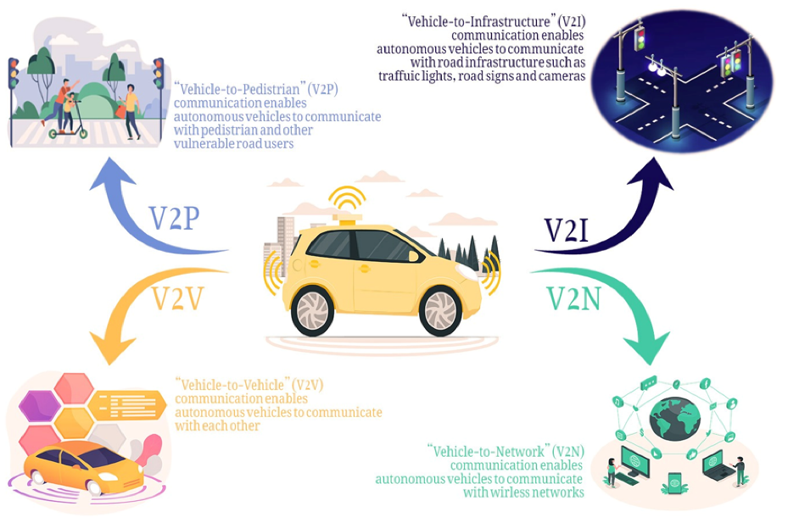
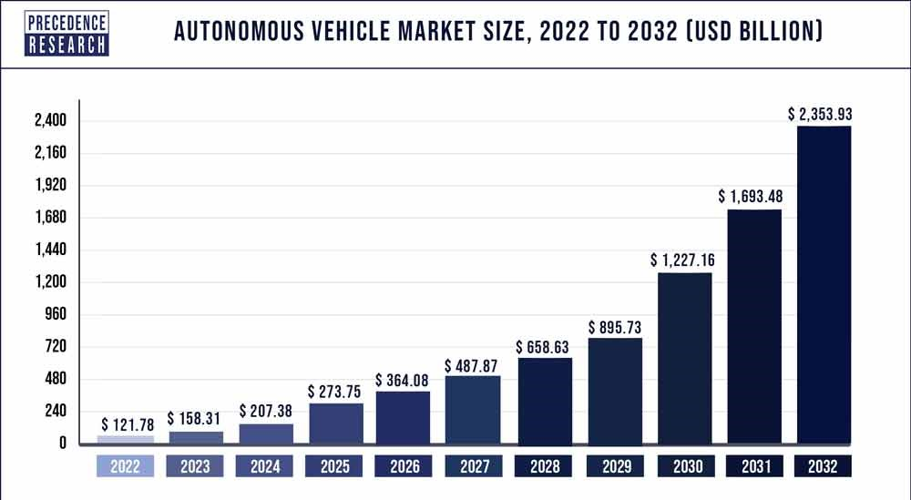

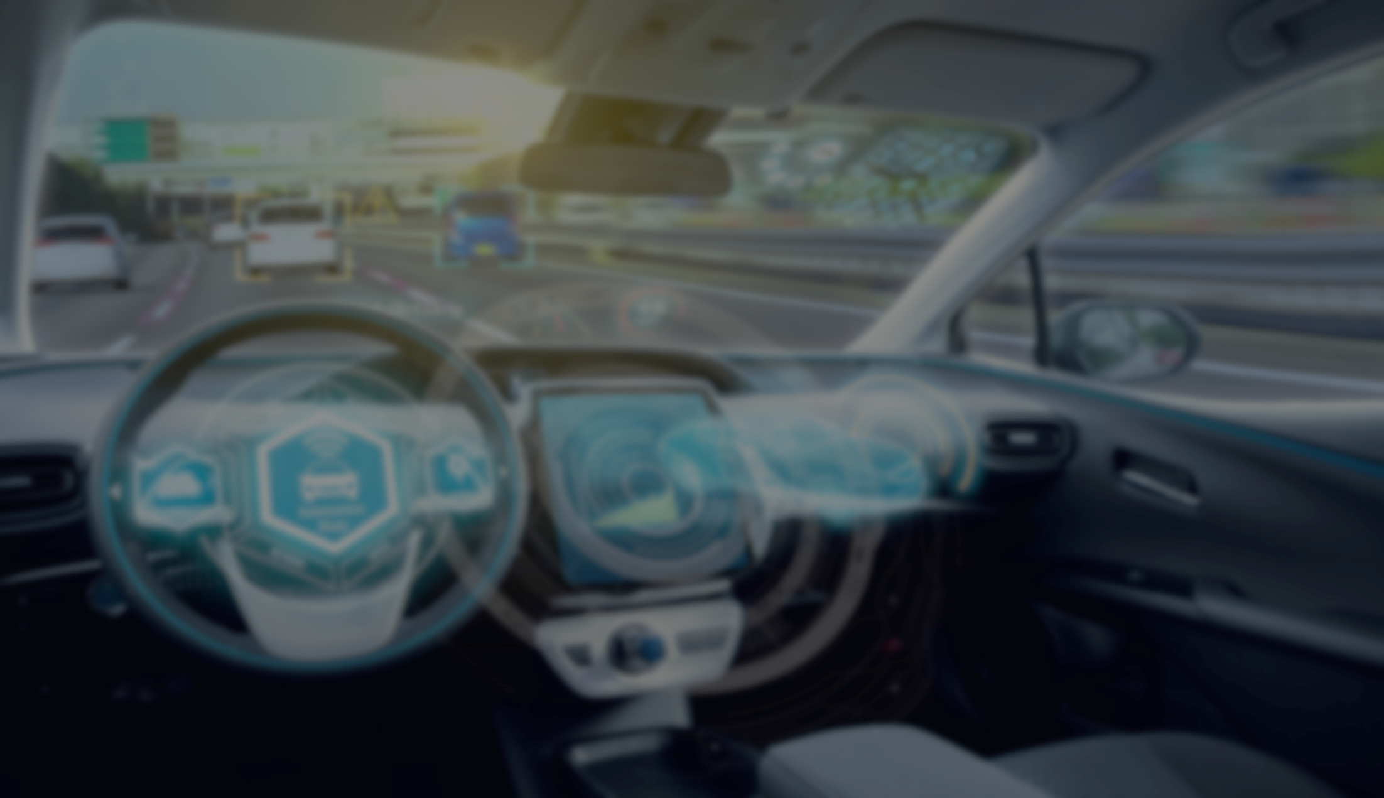
Artificial Intelligence and Sensor Based Autonomous Vehicles
Exultant 2k24 Poster Presentation
K.Jitendhar Reddy, B.Bhaskara Rao, 2nd Year ,CSE
Department of Computer Science and Engineering, Sai Ganapathi Engineering College, Visakhapatnam
Problem
EXECUTION MODEL
State of the ART
Today most of the accidents are occurring due to the negligence of driving and lost their lives. By the Autonomous vehicles will solve this problem. It consists AI , Sensors and complex Algorithms.
AI in cars utilizes deep learning technology to continuously improve its performance and make better decisions.
Having complex algorithms and processor in the automated vehicles.
Abstract
Autonomous driving is expected to revolutionize road traffic attenuating current externalities, especially accidents and congestion. Carmakers, researchers and administrations have been working on autonomous driving for years and significant progress has been made.
System architecture of autonomous vehicle
Pipeline of Car
Fully autonomous vehicles of different Brands
Autonomous cars create and maintain a map of their surroundings based on a variety of sensors situated in different parts of the vehicle. Radar sensors monitor the position of nearby vehicles. Video cameras detect traffic lights, read road signs, track other vehicles, and look for pedestrians.
Above graph shows about the top safe autonomous brands.
The below graph showing the Market values up to 2032.
Sensor Big Data Processing System
Connected and Automated Vehicles
Impact of AI & Sensors-Automated Vehicle
Applications
Autonomous Cars provides Safe driving as Experienced Driver.
Due to Autonomous Vehicles reduce the pollution.
By autonomous vehicles reduces Traffic.
Chooses less traffic routes to reach destination fast.
Parking places will be detected by themselves in the
school, shopping malls simply.
These are used in Aerospace.
Autonomous Vehicles are used in Mining.
Used automate various aspects of city operations.
Also applicable in emergency Vehicles like Fire Engine.
all automotive manufacturers are integrating self-driving solutions to stay competitive.
Also used in Health care to deliver medicines for villages.
References
Charlotte Trueman is a staff writer at Computerworld. She joined IDG in 2016 after graduating with a degree in English and American Literature from the University Kent. https://www.computerworld.com/article/3558622/everything-you-should-know-about-autonomous-vehicles-and-how-they-work.html
About the Autonomous vehicles & Market value: https://www.synopsys.com/automotive/what-is- autonomous-car.html https://www.precedenceresearch.com/autonomous-vehicle-market

